Slide 1
ENVIORNMENT
AND ITS COMPONENTS

Slide 2
1)Environment can be defined as the natural surroundings of that organism which directly or indirectly influences the growth and development of the organism.
2.Environment is the sum total of all living and non living factors that compose the surroundings of man .The word environment is derived from the French word “environ”. The meaning of the French word is somewhat related to “encompass” “encircle” etc. Itis believed to have been introduced into the subject by biologist Jacob Van Erkulin the early 1900s

Slide 3
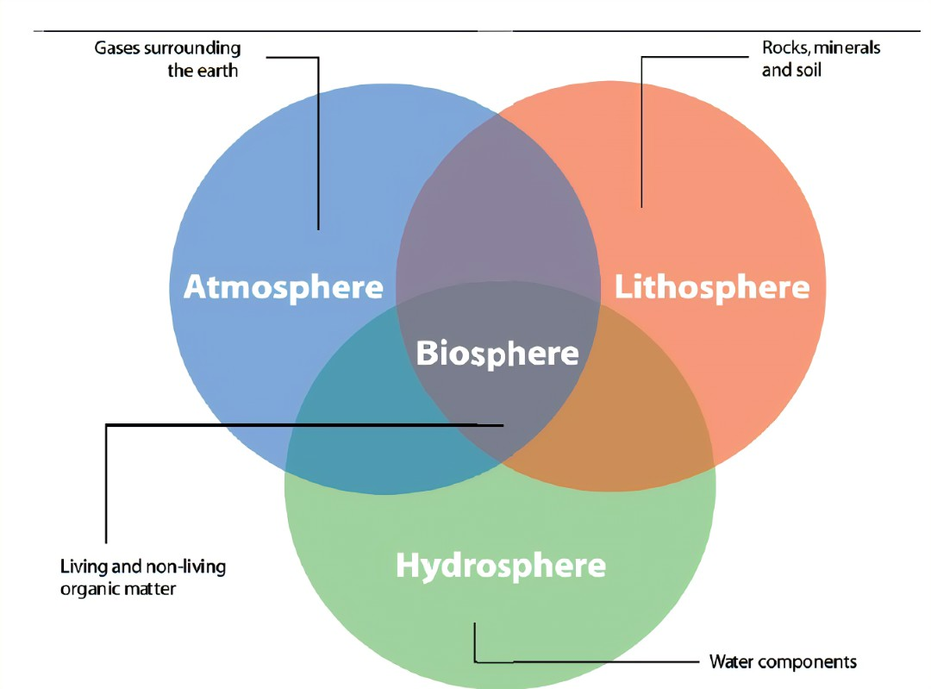

Slide 4
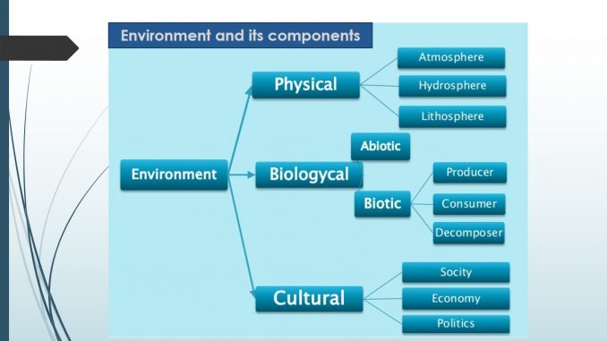

Slide 5
Physical component of environment:
Physical component of environment includes air, water, soil, light, temperature, climate, etc.
The physical components are also termed as abiotic components of the environment.
These environmental components accounts for determination of living conditions for the human population.
Physical component of the environment is again classified into three parts as follows: Atmosphere (gas) Hydrosphere,Lithosphere.

Slide 6
Biological component of environment:
The biological component of environment is also termed as biotic component.
This biological component includes all living things like plants, animals and small micro-organisms like bacteria, algae and fungi.
Biological component with the abiotic component of the environment. Interaction of these two components forms various ecosystems like forest ecosystem, pond ecosystem, marine ecosystem, desert ecosystem, etc.
Biosphere is independent and large ecosystem.
All ecosystems has three different types of living organisms; i.e. producers, consumers and decomposers.
Producer includes mainly green plants and other photosynthetic bacteria which synthesizes various organic substances such as carbohydrates, proteins, etc., with the aid of water, soil and light energy.
Consumers rely on green plants for their nutrition as these green plants produces organic food materials.
Decomposers are responsible to decompose dead plants and animals and yields various important minerals for the running of the natural cycle

Slide 7
Components of Cultural Environment
Nationality. The values, history and beliefs of every country defines the cultural environment amongst the citizens...
Religion. Religious practices and beliefs .
Language. The preferred language or mother tongue of a region, town, city, state or country .
Region. Regional factors like geography, terrain, climate etc. also creates a collective group or segment of people

